Slide 1
WELCOME

Slide 2
Would More Plain Language Have Saved Us from the Worst of the Pandemic?
Cynthia Baur, Ph.D.
Endowed Chair and Director, Horowitz Center for Health Literacy

Slide 3
Plain Language Standard
Communication your audience can understand the first time they read or hear it

Slide 4
From Another Pandemic: CDC Clear Communication Index
Part of reaction to 2009 pandemic flu
Tested terms after pandemic & found public still didn’t know & understand terms
Essential elements: main message, clear action steps, numerical & risk explanations

Slide 5
Throughline
2019: Bleach as Medicine
2021: Ivermectin as Medicine
“Iv” in Google search returns ivermectin first suggestion

Slide 6
Where We Started the Pandemic
U.S. officials said virus “low risk” to public in Jan/Feb 2020
“Low” & “risk” would score well on any readability assessment
Single syllable
Does “low risk” pass principal plain language standard?

Slide 7
Summer 2020 Pandemic Communication Trends
Jargon, jargon, jargon
Containment, mitigation, flatten the curve
Reliance on digital channels to distribute information
Lots of information but little tested with audiences
Reliance on morbidity & mortality stats

Slide 8
Changing Recommendations Compound Linguistic Challenges
Older adults or everyone at risk?
Mask or no mask?
What type of mask?
Indoor or outdoor or both?
What types of ventilation?
How much distancing & when?
What types of tests & how often?

Slide 9
On Humility When High Uncertainty
There’s still more we DON’T know than what we do know about immunity to the new coronavirus. Humility remains very much in order.
Dr. Thomas Frieden, former CDC Director, Sept. 15, 2020

Slide 10
Example: Emergency Use Authorization
Emergency Use Authorization
Use of EUA term is common, although unfamiliar acronym
“Emergency” common although multi-syllable word
Audience research shows people don’t trust or accept something with EUA
But this is affecting vaccines and not other COVID products, such as treatments

Slide 11
Example: Authorization and Approve
Anticipation that regulatory approval would convey different meaning than EUA
Approved or fully approved?
FDA press release used “approved”
Media and colloquial used “fully approved” or “full approval”

Slide 12
Example: Vaccines are Safe & Effective Message
Familiar words, short sentence
Aligned with audience question: why should I get vaccinated
What’s missing?
How do I know vaccines are safe?
How do I know you tested them on people like me?
Aren’t we all being experimented on?

Slide 13
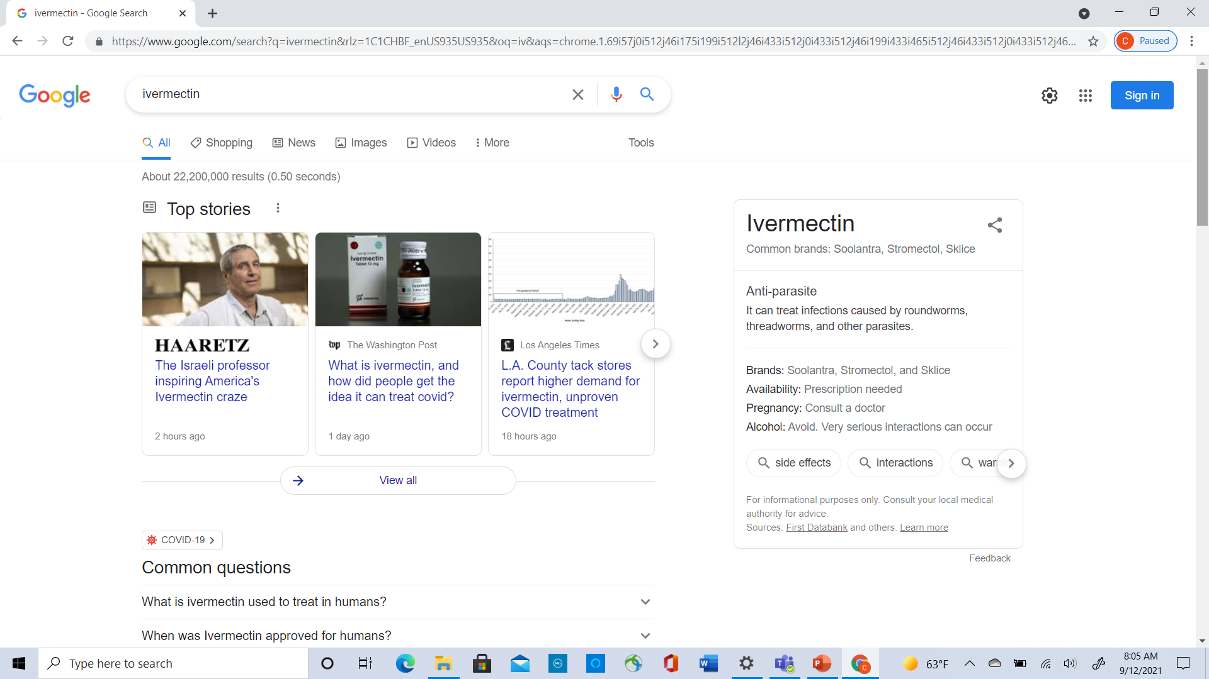
Temptingly Easy to Understand

Slide 14
Twitter Duels
Accounts with “MD” in name tweeting FDA approved ivermectin for humans
Challenge FDA’s statements about human use
“You are not a horse. You are not a cow. Seriously, y’all. Stop it.”
FDA Twitter account with webpage link

Slide 15
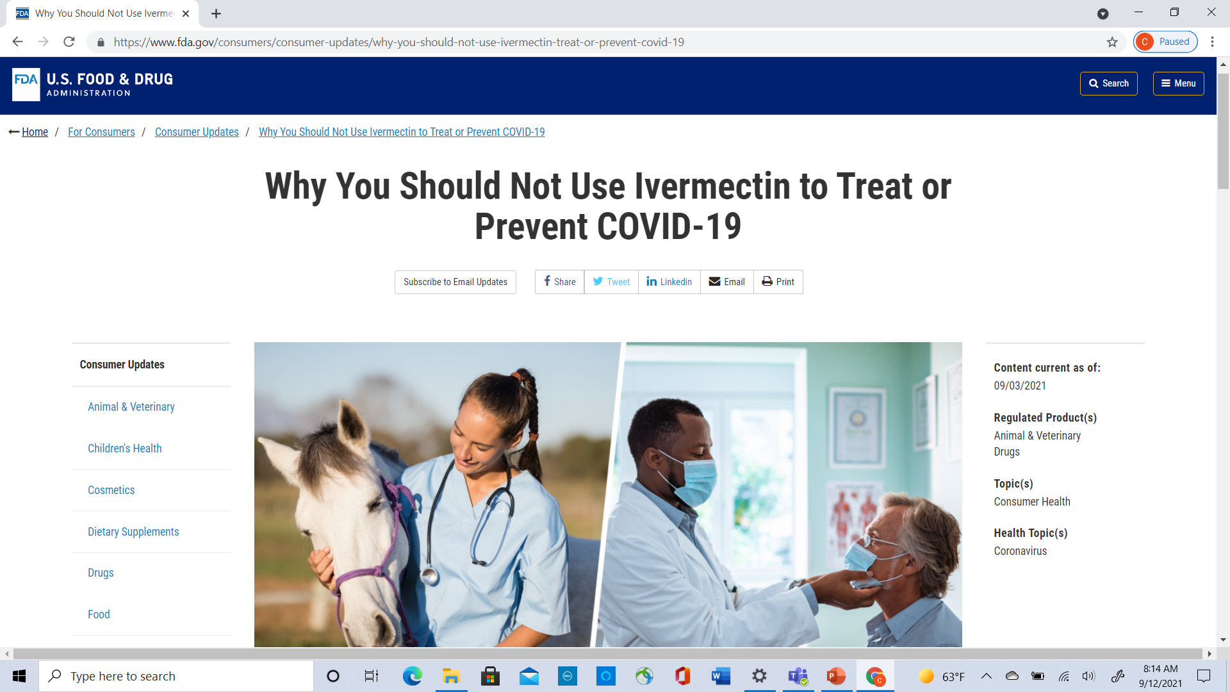
Plain Language Main Message

Slide 16
My Recommendations
Plain language standards
+
Accuracy
+
Humility
+
Deep Knowledge of Audiences’ Beliefs, Values & Prior Knowledge

Slide 17
My Answer
Plain language is a necessary but not sufficient requirement in complex communication situations
Plain language by itself couldn’t save us
But more plain language explanations might have provided firmer foundation for shifting science

Slide 18
Sources
Baur C. Bleach as Medicine: The Case for Plain and Accurate Information. 2019 Plain Language Summit.
CDC Clear Communication Index
Frieden T. A dozen observations about COVID-19 immunity. Sept. 15, 2020. Accessed Sept. 12, 2021, from https://www.drtomfrieden.net/blog/a-dozen-observations-about-covid-19-immunity
Quinn SC, Jamison AM, Freimuth V. Communicating effectively about emergency use authorization and vaccines in the COVID-19 pandemic. Am J Public Health. 2021; 111(3):355–358.
Rudd R, Baur C. Health literacy and early insights during a pandemic. J Communication in Healthcare. 2020; 13 (1): 13-16.

Slide 19
Thank You

